Slide 1
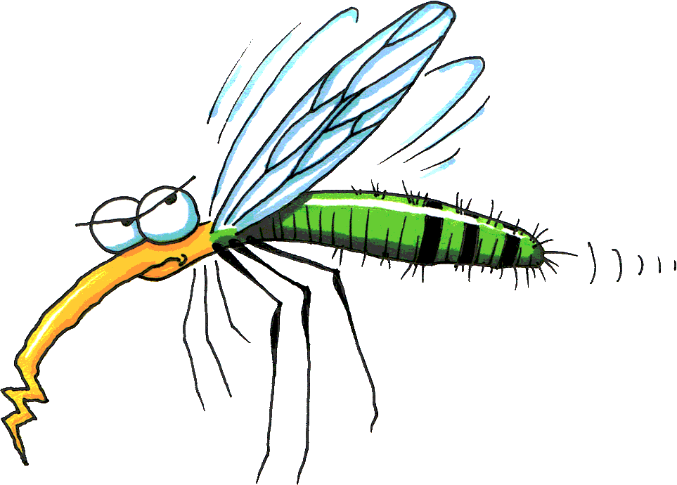
Malaria – Tropical Diseases Depth Study Two Unit 1 - GEOGRAPHY
A biological or chemical hazard that has the potential to impact adversely on the wellbeing of people or on the environment more generally.
Ecological hazards involve both biological and chemical agents.
Biological factors lead to infectious diseases. While many of these diseases have proven difficult to eradicate, enough is known about them to mount interventions that drastically reduce their incidence.

Slide 2
Malaria – Tropical Diseases Depth Study Two Ecological Hazards Unit 1 - GEOGRAPHY
Malaria is a disease caused by parasites that are carried by mosquitoes. Once in the bloodstream, the parasite inhabits the red blood cell (RBC).

Slide 4
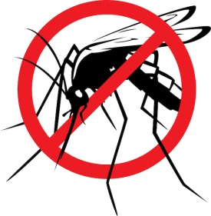
Key Information
Malaria is by far the most serious vector-borne disease in the World.
According to the WHO (World Health Organisation), there are more than 200 million people infected with malaria every year.
Malaria is a serious and sometimes fatal disease which is widespread in many tropical and subtropical countries.
It is caught by being bitten by an infected mosquito that is carrying the malaria parasites in its saliva.
The malaria parasite is a microscopic organism called Plasmodium and belongs to the group of tiny organisms known as protozoans.

Slide 5

Key Information
Malaria occurs in over 100 countries and more than 40% of the people in the world are at risk.
SYMPTOMS:
Flu-like illness
Headaches
Fever
Nausea
Vomiting
Muscle pains
Fatigue and tiredness
Chills and sweating
May cause anaemia and jaundice (yellow colouring of the skin)
COMPLICATIONS
Extensive destruction to red blood cells
Liver failure
Enlarged spleen
Dehydration
Kidney failure
Swelling of the brain due to blockages in small blood vessels.

Slide 6
Symptoms and the Nature of Malaria
For most people, symptoms begin 10 days to 4 weeks after the infection, although a person may feel ill as early as 8 days or up to a year.
Some parasites can rest in the liver for several months up to 4 years after a person is bitten by an infected mosquito.

Slide 7
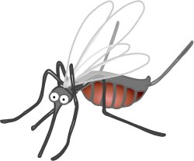
Transmission and Nature of Malaria
The parasites enter the host’s bloodstream when bitten by an infected mosquito and then migrate to the liver where they multiply before returning back into the bloodstream to invade the r____ b_______ c______.
The parasites continually multiply inside the red cells until they burst releasing large numbers of parasites into the blood plasma causing the characteristic fever associated with the disease. This phase of the disease occurs in cycles of 48 hours.
The free parasites are then able to infect any mosquito that feeds on the host’s (human) blood during this phase.
The cycle then continues as the parasites multiply inside the mosquito and eventually invade the salivary glands.

Slide 8
The spatial and temporal distribution of the hazard, and how an understanding of biophysical and human processes can be used to explain the patterns that are identified. Dot Point 12 syllabus
Spatial distribution means the arrangement of the geographical phenomena (malaria) across the Earth’s surface whilst temporal distribution is how wide spread has the phenomena (malaria) been over time.
Africa (Sub-Sahara in particular), South East Asia, South and Central America are the regions on Earth where incidences of malaria commonly occur. This is because the regions experience tropical and Equatorial conditions – hot and humid.
Africa has been at the heart of major incidences of malaria over time (temporal distribution). The African slave trade during the 17th and 18th centuries saw it move to the Americas . Yet the history of Malaria occurrences can be traced back much further than this by thousands of years.
Global movement of people around the world has meant that at the close of the 20th century, malaria on a global scale remained endemic in more than 100 countries throughout the tropical and subtropical zones, including large areas of Central and South America, Hispaniola (Haiti and the Dominican Republic), Africa, the Middle East, the Indian subcontinent, Southeast Asia, and Oceania.
As more than 1 billion people travel by air each year, planes can carry infected disease vectors (rats and malaria infected mosquitos) across the world within 24 hours.

Slide 9
Mosquitoes - Malaria
Malaria is transmitted among humans by female mosquitoes of the genus Anopheles.
Female mosquitoes take blood meals to carry out egg production and these blood meals are the link to human and the mosquito hosts in the parasite life cycle.
Several factors are linked to the successful development of the malaria parasite – important factors include humidity and ambient temperature.
Higher temperatures accelerate the parasite growth in the mosquito. Another factor is whether the Anopheles survives long enough to allow the parasite to complete its cycle in the mosquito host.
The mosquito host does not suffer noticeable effects from the presence of the parasites.

Slide 10
Do all mosquitoes transmit malaria?
Only certain species of mosquitoes of the Anopheles genus.
Malaria is caused by a one-celled parasite called a P________________.
Female Anopheles mosquitoes pick up the parasite from infected people when they bite to obtain blood required to nurture their eggs. The parasites reproduce and develop inside the mosquito. When the mosquito bites again, the parasites contained in the s_____________ gland are injected and pass into the blood of the person being bitten.

Slide 11
Extent & Spread of Malaria
Malaria is mainly spread through expansion diffusion.
Expansion diffusion occurs when an infectious disease is spread outwards from its source.
It is an example of an endemic disease.
Endemic diseases are diseases that consistently occur in a community or area.
Malaria mortality rates are highest in Africa.
Reason is that the African mosquito species have a relatively long lifespan. These species prefer to bite humans over animals.
Generally female A_______________ mosquitos live for 2-3 weeks.

Slide 12
Magnitude, duration, frequency, probability and scale of spatial impact of the hazard Dot Point 13 syllabus
Duration: Malaria is linked to seasonal weather patterns with infection rates rising during the wetter months when more water is in swamps, drains & lakes.
The incubation period is about 7 days (for the Anopheles mosquito) to 40 days. Once infected by the parasite, the illness is permanent with individuals showing various symptoms.
Where people are regularly bitten by infected mosquitos, there has been evidence of an immunity developed in the person.
Scale: some 3.4 billion people live in areas at risk of malaria transmission and malaria is the leading cause of death in developing nations (LDC’s) with young children and pregnant women vulnerable.

Slide 13
World Malaria Report 2014 by WHO
In 2013, there were an estimated 198 million cases of malaria (uncertainty range: 124–283 million)
In 2013, 584 000 malaria deaths globally (range: 367 000–755 000).
In 2013, approximately 82% of malaria cases and 90% of malaria deaths occurred in the WHO African Region, with children aged under 5 years and pregnant women most severely affected.
Malaria incidence rates are estimated to have fallen by 30% globally between 2000 and 2013, while estimated mortality rates fell by 47%.

Slide 14
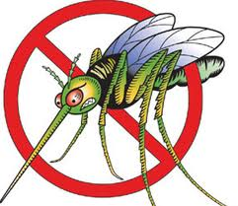
The nature of the risks to be managed Dot Point 11
When examining the concept of risk management in Malaria you need to consider the:
loss (potential loss of life)
vulnerability(measure of an inability to cope with malaria)
resilience (capacity to recover from malaria)
adaptation (change in behaviour to minimise future loss from malaria).
These four points will be considered throughout Dot Point 14, 15,17 & 18.

Slide 15

Vulnerability to Malaria
Approximately half the world is at risk of contracting malaria.
Children are more vulnerable to malaria since they have lower immunity against diseases, such as malaria.
Example – According to WHO (W______________ H________________ O_________________, approximately 600,000 children under the age of f_____ die from malaria each year in Sub-Saharan Africa.
Pregnant women are also vulnerable
People with AIDS/HIV are also vulnerable due to a weakened immunity or immune system.

Slide 16
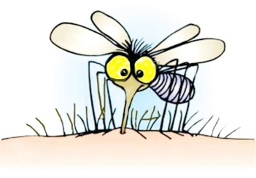
Malaria & Indonesia
117 million people in Indonesia live in areas endemic to malaria.
Cases of malaria are noted across many of Indonesia’s many islands.
Malaria is less widespread on the islands of Bali and Java where 70% of the population live.
Incidence of malaria infections sometimes increases of intensifies due to physical factors, such as disasters.
Example – a malaria epidemic occurred when Indonesia was hit by a tsunami in 2004 (Boxing Day Tsunami). Pools of stagnant water left behind by the tsunami event, combined with heavy rains provided suitable conditions for breeding (mosquitos). Survivors of the tsunami became more vulnerable to malaria infection.
http://www.who.int/malaria/publications/country-profiles/profile_idn_en.pdf

Slide 17
The PHYSICAL and HUMAN FACTORS that explains why some people and places are more vulnerable to Malaria. Dot Point 14 The activities of people can certainly intensify the impacts of malaria. Dot Point 15 (Students are to develop this table and fill out accordingly)
Physical Factors | Human Factors
Pages 62-68 | Pages 74-75

Slide 18

Factors contributing to the spread of Malaria
SOCIO – ECONOMIC FACTORS: (HUMAN FACTORS)
☒ Overcrowded living conditions:
Refers to situations where large numbers of people live very close together in small areas. People interact with each other more often and more closely. As a consequence, diseases spread easily and quickly.
Overcrowded housing, unhygienic conditions. Houses sometimes do not have proper doors and windows to keep out Anopheles mosquitos that tend to be active at night.
The crowded living conditions also mean that mosquitos can move from one person to another person.
Lack of proper sanitation:
The lack of proper sanitation can contribute to the spread of malaria.
If waste water is not disposed of properly, stagnant pools of water will then appear in these areas. Pools of water replenish when it rains and provide ideal breeding grounds for mosquitos.

Slide 19

Limited provision of and access to health care
Limited access to and provision of health care – reasons include shortage of doctors, lack of medical and health services in rural areas
Cost of malaria treatment can contribute to the spread.
Malaria treatment tends to be costly and unaffordable in many developing of LDC’s (Less Developed Countries) where the disease is prevalent.
Poor drainage
Poor drainage of water provides ideal conditions for growth in mosquito populations.
Areas which experience limited education or knowledge of malaria are vulnerable as no precaution or effort is taken to remove stagnant water.
*** Malaria is increasingly the result or intensified by ‘human factors’ and activities, such as air travel, tourism, living standards etc rather than being determined or influenced by environmental conditions or ‘physical factors’.

Slide 20
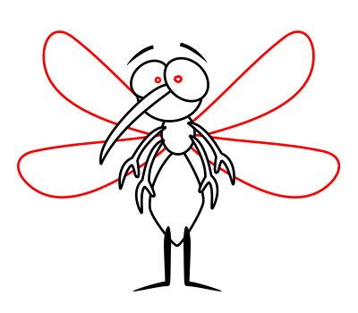
Factors contributing to the spread of Malaria
PHYSICAL FACTORS:
Climate
Rainfall, r______________ h____________ and t__________________ all have a direct affect or impact on mosquitoes.
Monsoons create ideal conditions for mosquitoes to breed as they often result in large amounts of rainfall.
Habitats for m________________ to breed – pools of stagnant water.
Habitats may be removed when rainfall is too high, since s______________ water may be washed away.
Relative humidity that ranges from 50% to 60% is required for the activity and survival of mosquitoes.
Higher humidity levels → longer lifespan of mosquitoes→ more infected.

Slide 21
Environmental:
Disruption to ecosystems
Preventative sprays such as DDT and impact on agriculture etc…
Social:
High Death Rate
High Infant mortality rate . Including pregnant women may infect the unborn child.
Insecticide treated nets
Days lost from school.
Funeral costs
Travel expenses to obtain treatment.
Purchasing medical supplies and medication
Lost income from days off work
Preventative measures
Causes an increase in spending for households
Expensive for government – health care services, lost income as people are out of work.
IMPACTS
Economic:
Pressure of malaria on households – economic burden of increased medical costs
Cost of health care - including building and maintaining hospitals
Loss of productivity - lower productivity impacts on slowing down economic growth.

Slide 22
Pronounce this…
dichlorodiphenyltrichloroethane

Slide 23
Impacts in an LDC – Indonesia
List examples of the impact which occur in an LDC as opposed to an MDC.

Slide 24
Malaria’s impact on people, property and economic activity Dot POINT 16
It is in LDC’s that Malaria is seen at its greatest.
There is a strong link (correlation) between it, poverty and geography. Many of these affected LCD’s are located in the tropical and Equatorial regions of Earth.
Examine the social and economic impacts of malaria by reading and taking notes from pages 72-73 of the textbook and other sources.
Question: Why is malaria often more dangerous to people in regions where it is not widespread?

Slide 25
The sustainability of risk management policies, procedures and practices designed to reduce the impacts of Malaria in the short and long term (prevention, mitigation and preparedness) Dot Point 18
Pages 69, 76-77
Read and answer questions –
2
3
4
Extension – Question 1 (complete for homework/revision in preparation for next assessment) DUE: MONDAY 7TH OF MAY

Slide 26
Page 73 – Question 6
End

Slide 27
Challenges in managing the spread of Malaria
Social and Economic Challenges:
Health care:
resistance to drugs is caused by incompletely treating an infected person. The surviving parasites sometimes then develop a resistance to the drugs being used.
Human Activities:
Population movement – the movement of people transmits and spreads diseases to new locations and areas.
Border Control
Travel advisory information – DFAT (Australian Government) -
travel information to inform travellers about specific risks when visiting particular destinations, such as SmartTraveller website information. Available on the internet, yet may not be accessible by everyone.
Forest Clearance:
Cleared land can provide ideal conditions and suitable habitats for mosquitoes to breed. Irrigation-based agriculture can also assist in an increase in mosquito breeding, such as rice fields/paddies.

Slide 28
Challenges in managing the spread of Malaria cont…
Environmental challenges:
Climate
Changes and variations in amount of rainfall and temperature impact on both the range and behaviour of mosquitoes.
Increased temperatures impact on the rate at which mosquitoes breed and mature
Stagnant water is prominent when there are higher amounts of rainfall.
Monsoons – the number of malaria cases increases.

Slide 29
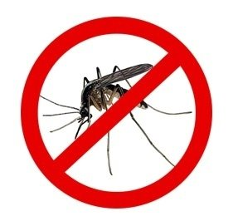
PREVENTION
Malaria is a preventable and treatable disease.
Malaria can be prevented in a variety of ways:
Using repellent sprays to get rid of mosquito breeding sites in homes.
Using bed nets treated with insecticides or in unavailable, nets that have small enough mesh to stop mosquito entry.
Putting screens in windows and doors to stop mosquitoes entering.
Reducing breeding grounds for mosquitoes, such as keeping water containers covered.
Informing people about malaria – education, danger signs.
Informing and advising people to access treatment early if they suspect malaria.

Slide 30
The ABCD of Malaria Prevention & Treatment
A - Be AWARE of the risk of malaria if you are travelling to a country which is vulnerable to malaria.
B - Avoid mosquito BITES by taking appropriate measures. Reducing the number of bites, will then reduce the chances of getting malaria.
C – COMPLY with the appropriate treatment regimen.
D – Early DIAGNOSIS of Malaria.

Slide 31
SEE – Social, Economic & Environmental Impacts
List examples of each in relation to Malaria

Slide 32
Re-emergence of Malaria
A program called “The Global Malaria Eradication Programme”, ran in the 1950s and 1960s resulted in a large reduction in malaria in many countries and locations around the world. However, this program did not lead to global eradication of malaria.
Malaria has re-emerged since the late 1980’s, particularly in countries in Central Asia.
Factors leading to the re-emergence of malaria include:
- air travel – due to an increase in air travel, vectors can be transported to new areas.
- climate change – when the climate gets warmer, temperatures at higher altitudes increase.
- insecticide-resistant mosquitoes – use of chemical pesticide DDT was replaced by other chemicals
- resistance to anti-malarial drugs – rise in the use of incomplete doses and use of counterfeit anti-malarial drugs. Malaria parasites build resistance.

Slide 33
Prevention of Malaria
How can people prevent malaria?
Take an antimalarial drug (4-6 weeks before travel, prescription)
Prevent mosquito bites.
Malaria is both treatable and preventable, however, it depends on various factors… Think of examples?
Preventable and curative tools developed over time.

Slide 34
STAKEHOLDERS
List 8 stakeholders
Explain the various values and viewpoints of three stakeholders

Slide 35
Examples of Stakeholders
WHO – World Health Organisation
UNDP – United Nations Development Programme.
???
???
???

Slide 36
Malaria in an MDC - Australia
In Australia, malaria is endemic.
Malaria was declared eradicated from Australia in 1981. WHO declared Australia malaria free in 1981.
Northern parts of Australia are at future risk – why?
The last major outbreak in Australia occurred at the end of World War II, when servicemen infected with malaria returned from Papua New Guinea.
There are about 700-1000 cases each year, due to people contracting the disease overseas.
RISK MANAGEMENT – How is the risk managed in terms of Malaria in Australia (MDC)? List examples!

Slide 37
LDC’s V MDC’s
Indonesia (LDC)
Higher population density – larger proportion of young children.
Possible lack of regulation, including building codes, rules on building. Often planning impacts on recovery.
Lack of resilience – Why?
Limited financial resources
Type of industry – agriculture such as rice cultivation is typically “subsistence”.
Australia (MDC)
Ability to reduce risks associated with hazards, such as bushfires and malaria.
Preparedness by organisations, including government.
Education programs
Mitigation of impacts – disaster planning and management.
Production and industry returns faster.

